Slide 1
Drug Addiction and its effects on Others and Society
Dantereus James
Honors English 4
Ms.Halverson

Slide 2
Table Of Contents
Thesis: drug addicts affect more than just themselves but also the people around that person and society. Also the government should monitor their citizens better.
My Goal
What exactly is drug addict?
History of The Big Three
Chart
Modern Drugs
Marijuana
Cocaine
Heroine
DEA
Product
Work Cited

Slide 3
My Goal
My goal is to inform you about the origin of drugs and the effects on people and society rather than the one’s that you ma already know.

Slide 4
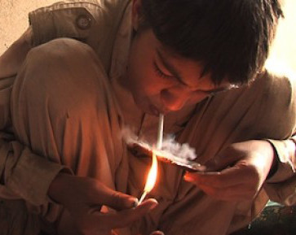
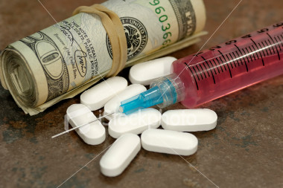
What is an drug addict?
A drug addict is someone who has compulsive and, at times, uncontrollable drug cravings, seeking for drugs in every way that a person knows how.

Slide 5
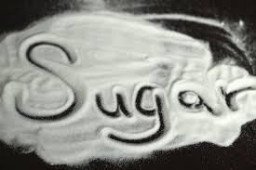
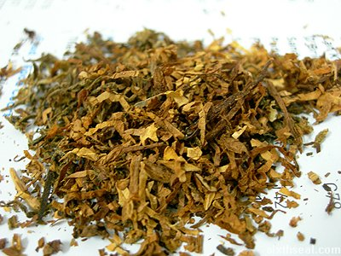
The Big Three
In 1612 John Rolfe planted and sold the world’s first “drugs”
"Big Three” the three most important drugs in American history. They are alcohol, tobacco and caffeine.
If that threesome seems shocking, it's because those three drugs are so universal in our society that we often don't even think of them as drugs at all. They are so widely used, and so accepted in our society, that users of the "Big Three" usually don't face the social stigma (to say nothing of the criminal sanctions) suffered by users of illegal drugs like marijuana or cocaine. Habitual users of the "Big Three" drugs almost certainly don't think of themselves as drug addicts.

Slide 6
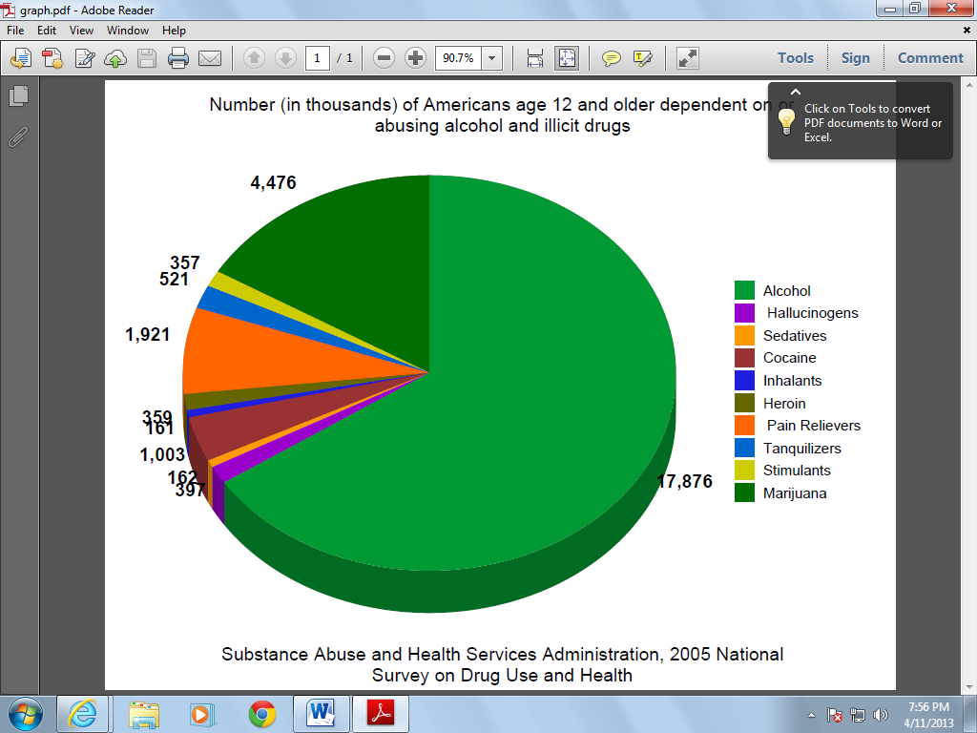
Chart
I created this chart from information that was conducted In 2009. Approximately 7 million people were current users of prescription pain relievers, stimulants, and antidepressants but not for valid medical reasons which was 2.8 percent of the U.S. population

Slide 7
Modern Drugs
In 2011, marijuana was the most commonly used illicit drug, with 18.1 million current users. It was used by 80.5 percent of current illicit drug users. The reason marijuana was the most in 2011 was because many individuals started selling it to make money and it is very easy to get the product.
Heroin was first manufactured in 1898 by the Bayer pharmaceutical company of Germany and marketed as a treatment for tuberculosis as well as a remedy for morphine addiction.
Cocaine comes from the leaves of the coca plant that grows in the Andes Mountains in South America.

Slide 8
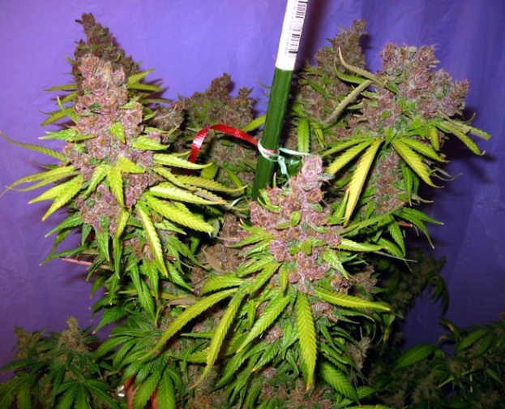
Marijuana
Also known as cannabis, marijuana is one of the world’s most easiest drug to get a hold too.
In 1545 the Spanish brought marijuana to the New World. The English introduced it in Jamestown in 1611 where it became a major commercial crop alongside tobacco and was grown as a source of fiber.

Slide 9
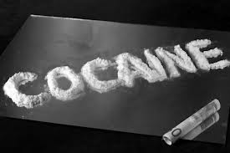
Cocaine
Cocaine is a powerfully addictive stimulant drug made from the leaves of the coca plant native to South America. It produces short-term euphoria, energy, and talkativeness in addition to potentially dangerous physical effects like raising heart rate and blood pressure.

Slide 10
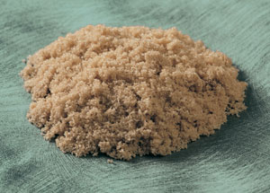
Heroin
Heroin produces a "downer" effect that rapidly induces a state of relaxation and euphoria
Like other opiates, heroin use blocks the brain's ability to perceive pain.
Comes from the poppy seed. Poppy flowers were discovered as early as 3400 BC, the opium poppy flowers were grown and harvested in Mesopotamia.

Slide 11
Effects on the Body
Marijuana affects brain development, and when it is used heavily by young people, its effects on thinking and memory may last a long time or even be permanent.
Cocaine is a strong central nervous system stimulant that increases levels of the neurotransmitter dopamine in brain circuits regulating pleasure and movement.
When heroine enters the brain, heroin is converted back into morphine, which binds to molecules on cells known as opioid receptors. Opioid receptors are also located in the brain stem, which controls automatic processes critical for life, such as blood pressure, arousal, and respiration.

Slide 12
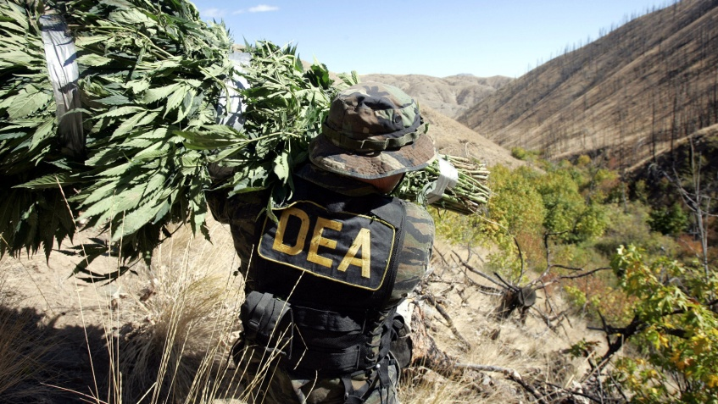
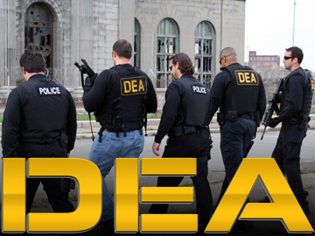
DEA
The Drug Enforcement Administration was created by President Richard Nixon through an Executive Order in July 1973 in order to establish a single unified command to combat "an all-out global war on the drug menace." At its outset, DEA had 1,470 Special Agents and a budget of less than $75 million.
Today, the DEA has nearly 5,000 Special Agents and a budget of $2.02 billion.

Slide 13
Product Overview
I will be making a website to inform people of the dangers and outcomes of using drugs.

Slide 14
Work Cited
"MISSION: The Addict Experience Explained By Neuroscience." Addict Science Home Comments.N.p.,n.d. Web. 14 Mar. 2013.
"Get Help Today! Call 877-378-6407 or Request A Confidential Assessment." Drug Addiction Treatment.N.p.,n.d. Web. 14 Mar. 2013.
"Effects of Substance Abuse on Families."Chicagotribune.com. N.p., n.d. Web. 14 Mar. 2013.
"Ben Goldacre: What Doctors Don't Know about the Drugs They Prescribe." TED: Ideas worth Spreading. N.p., n.d. Web. 14 Mar. 2013.
"Trends & Statistics."National Institute on Drug Abuse.N.p.,n.d. Web. 14 Mar. 2013.
"Prescription Drug Abuse: A Fast-Growing Problem." Google Images.N.p., n.d. Web. 10 Apr. 2013
"Drug-Induced Diseases."WorstPills.org -.N.p., n.d. Web. 04 Apr. 2013

